Slide 1
Data Serialization
Session 11
Course : COMP6584001 – Network and Systems Programming
Ivan Sebastian Edbert

Slide 2
Learning Objectives
At the end of this session, the student will be expected to :
Able to serializing object
Able to transmitting Serialized Objects

Slide 3
Outline
Serializing Object
Transmitting Serialized Objects

Slide 4
Serializing object

Slide 5
Serializing object
Serializing an object refers to the process of converting an object's state into a format that can be easily stored, transmitted, or reconstructed. In programming, this often involves converting an object into a byte stream or a string. Serialization is commonly used in scenarios such as data persistence, network communication, and inter-process communication. In Go, you can use the encoding/json package for JSON serialization, and the encoding/gob package for Go-specific binary serialization.

Slide 6
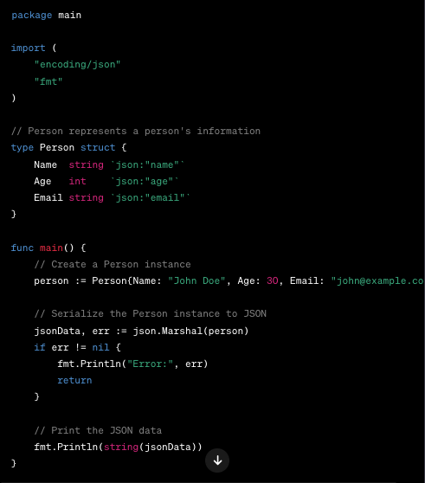
Serializing object
JSOn Serialization
The encoding/json package in Go provides functions for encoding and decoding JSON data. Here's an example of serializing a Go struct to JSON.
In this example, json.Marshal is used to serialize the Person struct to a JSON-encoded byte slice (jsonData). The struct field tags (json:"...") provide the mapping between struct field names and JSON field names.

Slide 7
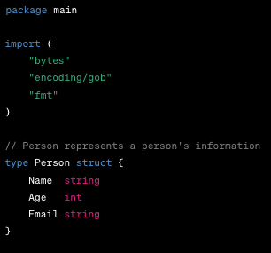
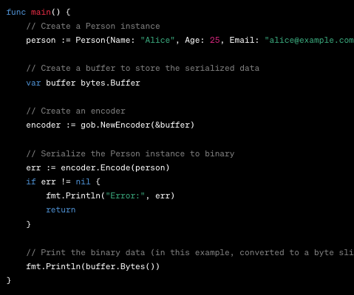
Serializing object
Binary Serialization (using Gob)
The encoding/gob package is used for binary serialization and deserialization in Go. Here's an example:
In this example, json.Marshal is used to serialize the Person struct to a JSON-encoded byte slice (jsonData). The struct field tags (json:"...") provide the mapping between struct field names and JSON field names.

Slide 8
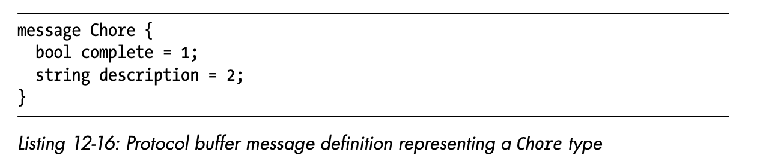
Serializing object
Protocol buffer
Like Gob, protocol buffers use binary encoding to store or exchange informa- tion across various platforms. It’s faster and more succinct than Go’s JSON encoding. Unlike Gob and like JSON, protocol buffers are language neu- tral and enjoy wide support among popular programming languages. This makes them ideally suited for using in Go-based services that you hope to integrate with services written in other programming languages. This chap- ter assumes you’re using the proto3 version of the format.
Protocol buffers use a definition file, conventionally suffixed with .proto, to define messages. Messages describe the structured data you want to serial- ize for storage or transmission. For example, a protocol buffer message rep- resenting the Chore type looks like the definition in Listing 12-16.

Slide 9
Transmitting Serialized Objects

Slide 10
Transmitting Serialized Objects
Grpc
gRPC (gRPC Remote Procedure Calls) is a high-performance, open-source framework for building efficient and scalable distributed systems. It uses the Protocol Buffers (protobuf) as its interface definition language and provides features such as bi-directional streaming, flow control, and pluggable authentication.
In this example will show you how to create a simple gRPC service and client in Go.

Slide 11
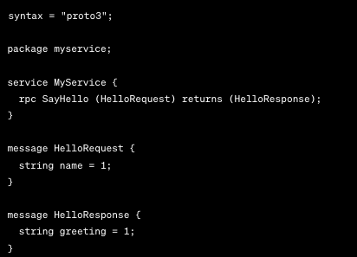
Transmitting Serialized Objects
Grpc
Define the protocol buffers (protobuf) Service:

Slide 12
Transmitting Serialized Objects
Grpc
Generate gRPC Code:
protoc --go_out=. --go_opt=paths=source_relative --go-grpc_out=. --go-grpc_opt=paths=source_relative service.proto

Slide 13
Transmitting Serialized Objects
Grpc
package main
import (
"context"
"fmt"
"log"
"net"
"your_module_path/myservice" // Replace with your actual module path
"google.golang.org/grpc"
)
type myServiceServer struct{}
func (s *myServiceServer) SayHello(ctx context.Context, req *myservice.HelloRequest) (*myservice.HelloResponse, error) {
greeting := fmt.Sprintf("Hello, %s!", req.GetName())
return &myservice.HelloResponse{Greeting: greeting}, nil
}
func main() {
listener, err := net.Listen("tcp", ":50051")
if err != nil {
log.Fatalf("Failed to listen: %v", err)
}
server := grpc.NewServer()
myservice.RegisterMyServiceServer(server, &myServiceServer{})
log.Println("gRPC server is running on :50051")
if err := server.Serve(listener); err != nil {
log.Fatalf("Failed to serve: %v", err)
}
}
Implement the Server:

Slide 14
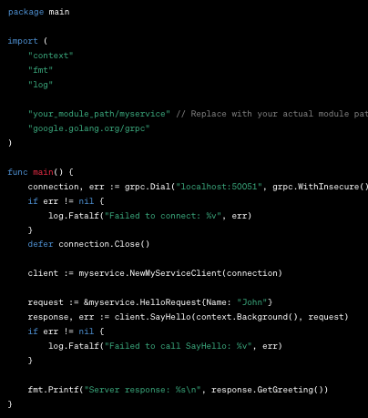
Transmitting Serialized Objects
Grpc
Implement the Client:

Slide 15
Transmitting Serialized Objects
Grpc
Runt the Server and Client:
go run server.go
You should see the client receiving a greeting message from the server.
This is a basic example, and gRPC offers much more advanced features like bidirectional streaming, error handling, and support for different data types. Adjust the code and protobuf definitions based on your specific use case.

Slide 16
references
Adam Woodbeck - Network Programming with Go_ Learn to Code Secure and Reliable Network Services from Scratch-No Starch Press (2021).

Slide 17
Thankyou

